Slide 1
On the Go
Dana Mounayer & Judy Al Imam
CS 2111 - section 1

Slide 2

Website Idea
On The Go is a website mostly for teens and young adults who love car rides and want quick options for drive-thrus in Jeddah. It makes finding drive-thru spots easier by showing their menus, ratings, and specialties so you can choose the best place fast.

Slide 3
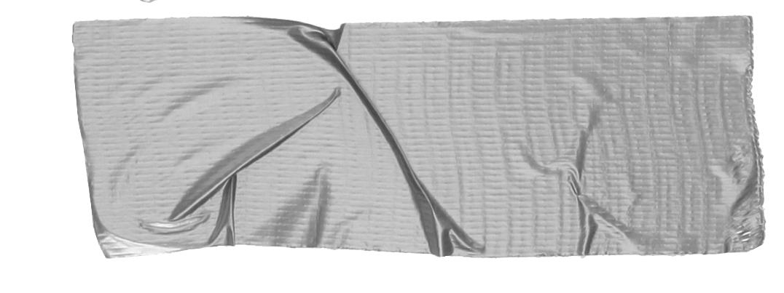

1. Intro
Today, We’ll take you through the features, layout, and unique aspects of our website that set it apart.
We’ll explore how 'On The Go' transforms the traditional drive-thru experience into a more connected and efficient process.

Slide 4
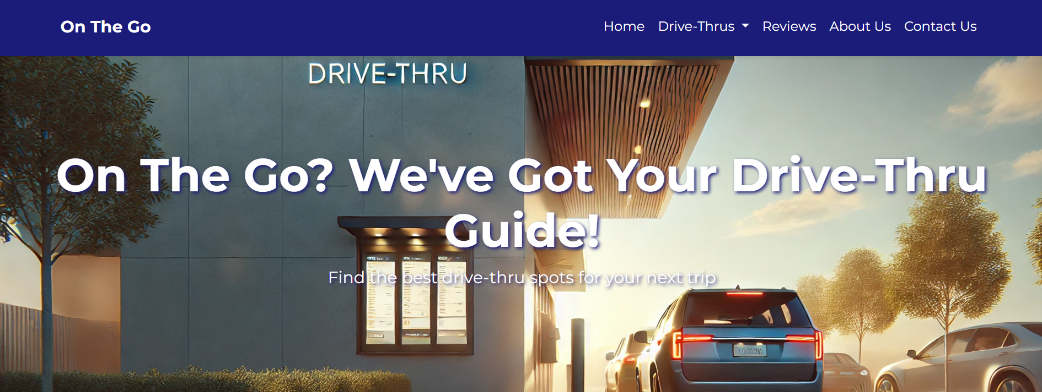
Our website consists of six distinct pages: Home, Drive-Thrus (separate sections for food and drinks-desserts), Reviews, About Us, and Contact Us, each with its own unique content and layout.

Slide 5
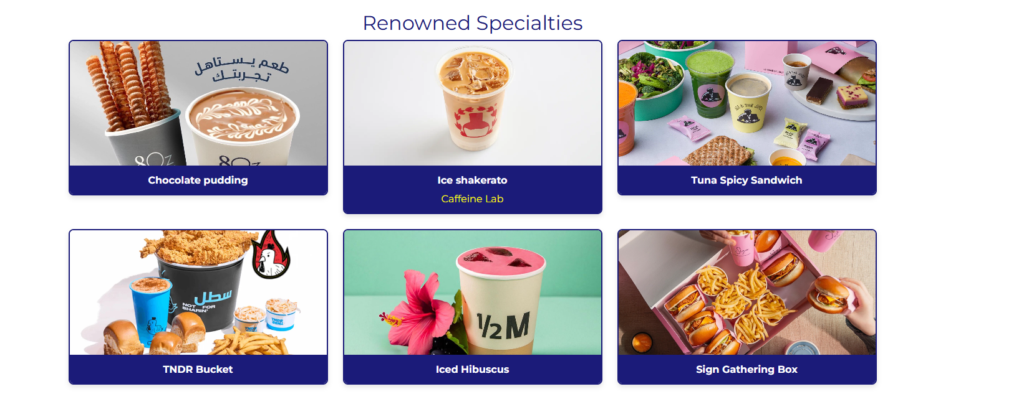
Renowned Specialties
This section of the homepage shows the best-selling items from the most popular drive-thrus, with a hover effect that scrolls the names of each drive-thru.

Slide 6
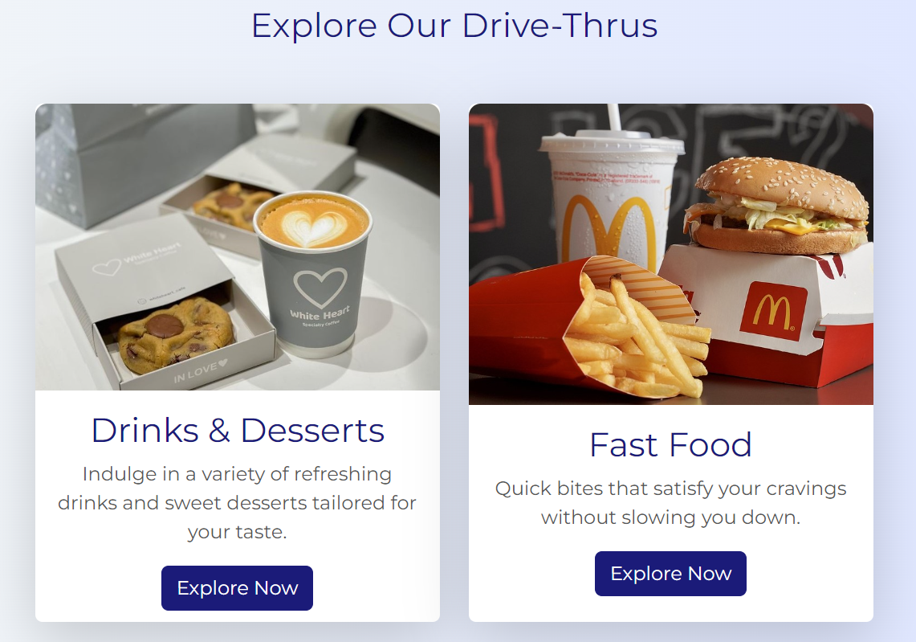
The Google Translate app can repeat anything you say in up to NINETY LANGUAGES from German and Japanese to Czech and Zulu
2 CATEGORIES
This section of the homepage allows the user to choose their preference: drinks & desserts or fast food with an “Explore Now” button to dive into each section.

Slide 7
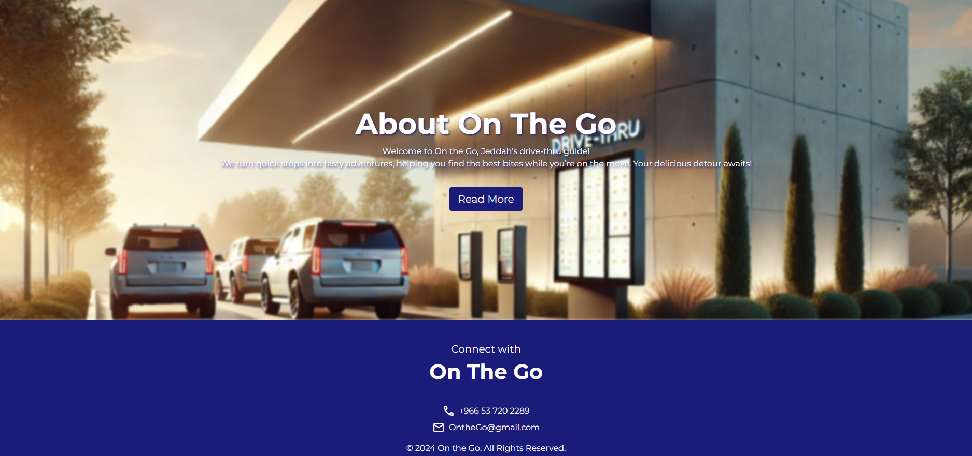
About On The Go The final section, About On The Go, includes a "Read More" button that directs users to the About Us webpage, where they can find detailed information about our website and its offerings.
Footer Section In the footer, On The Go provides easy contact options with a phone number and an email address, accompanied by icons sourced from Google Fonts, making it simple for users to connect with us.

Slide 8
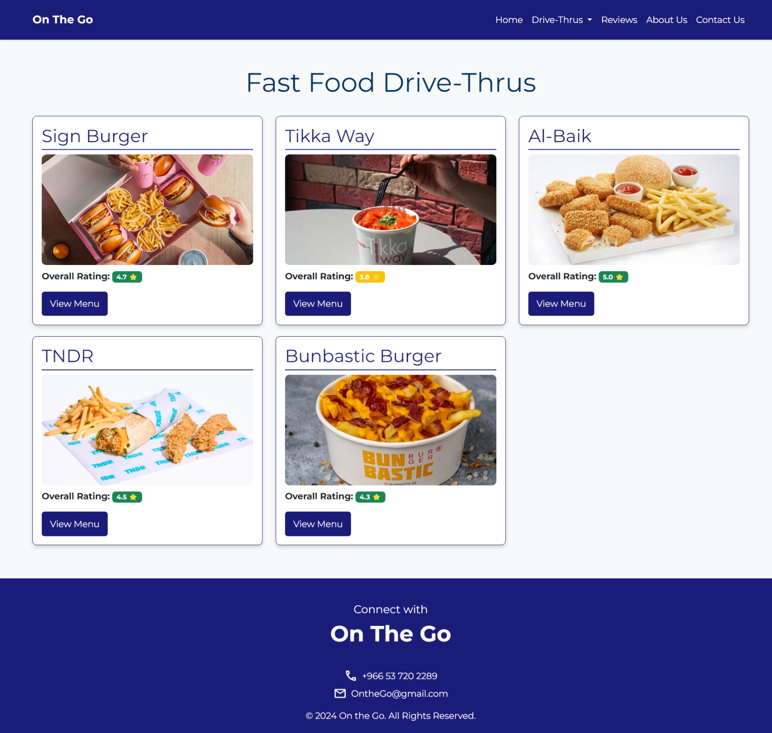
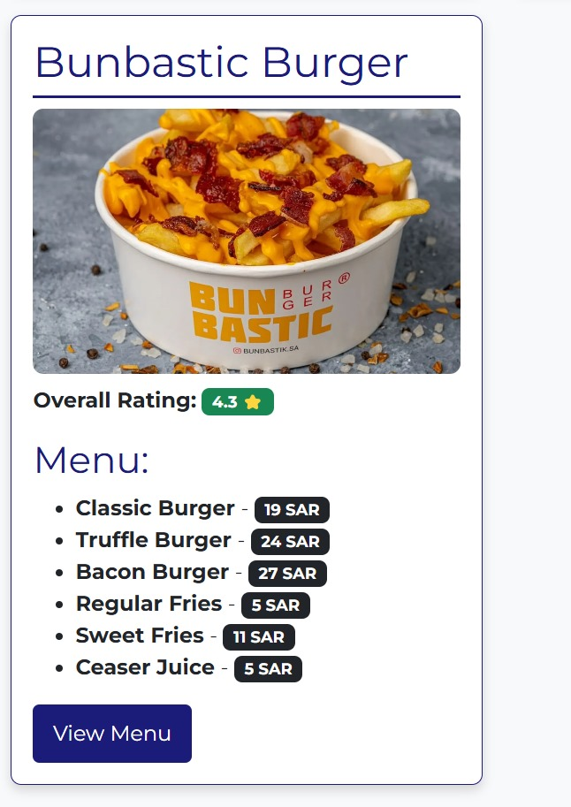
Displays a grid of fast food drive-thrus with their name, image, rating, and a "View Menu" button that scrolls down to the selected drive-thru's menu.

Slide 9
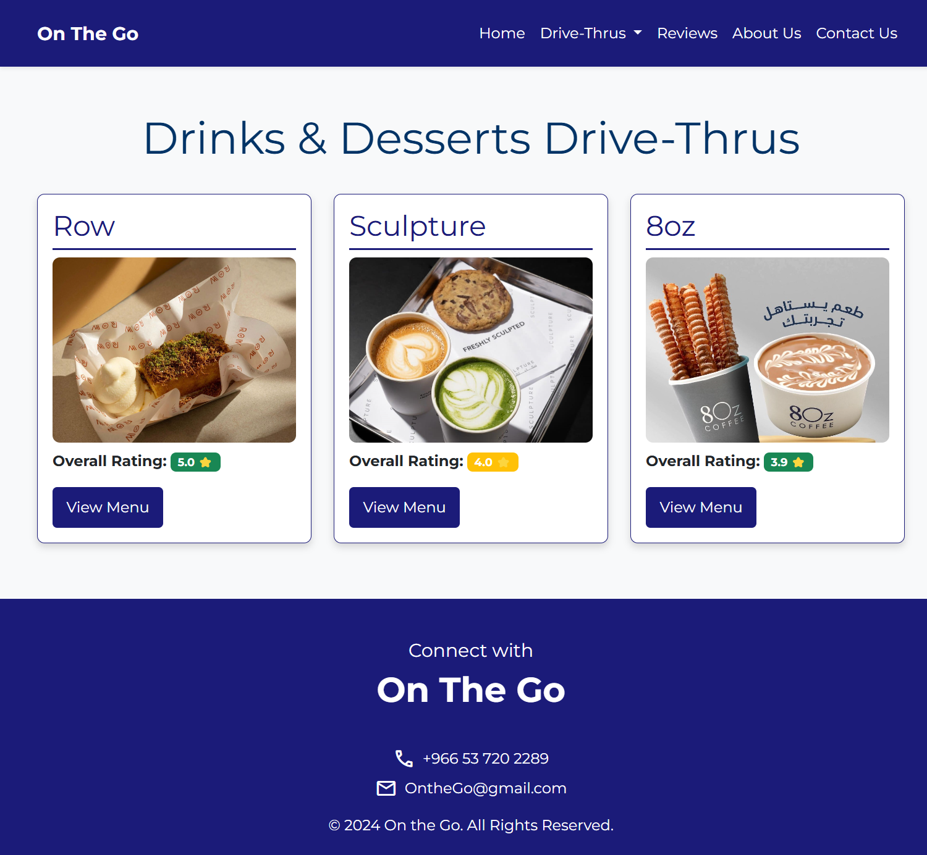
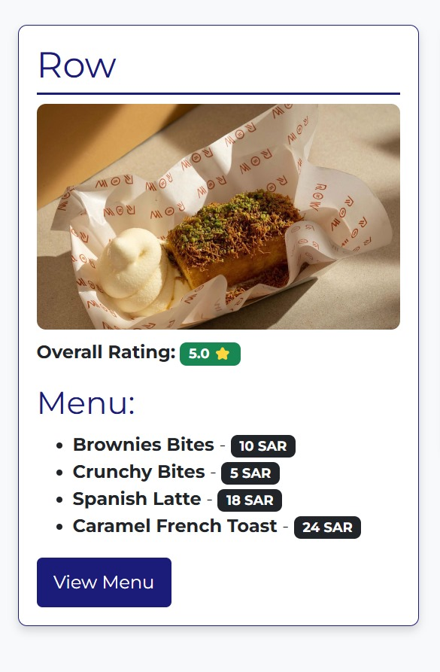

Slide 10
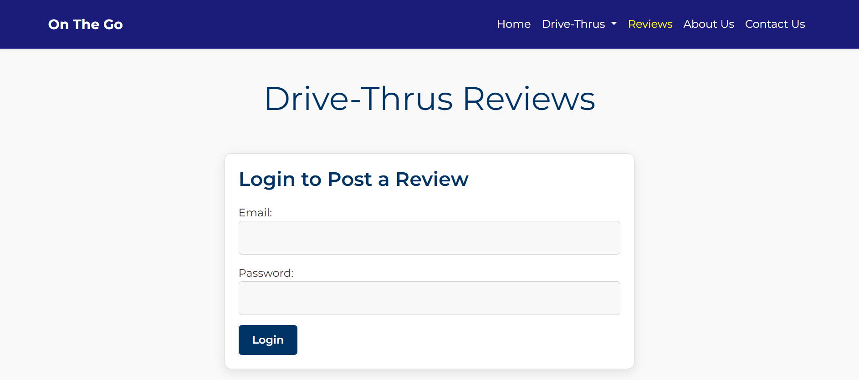
When the user enters their login information, their credentials are hashed and compared against the stored hash in our database to verify their identity. This ensures that the actual passwords are never exposed, providing an additional layer of security during the authentication process.

Slide 11
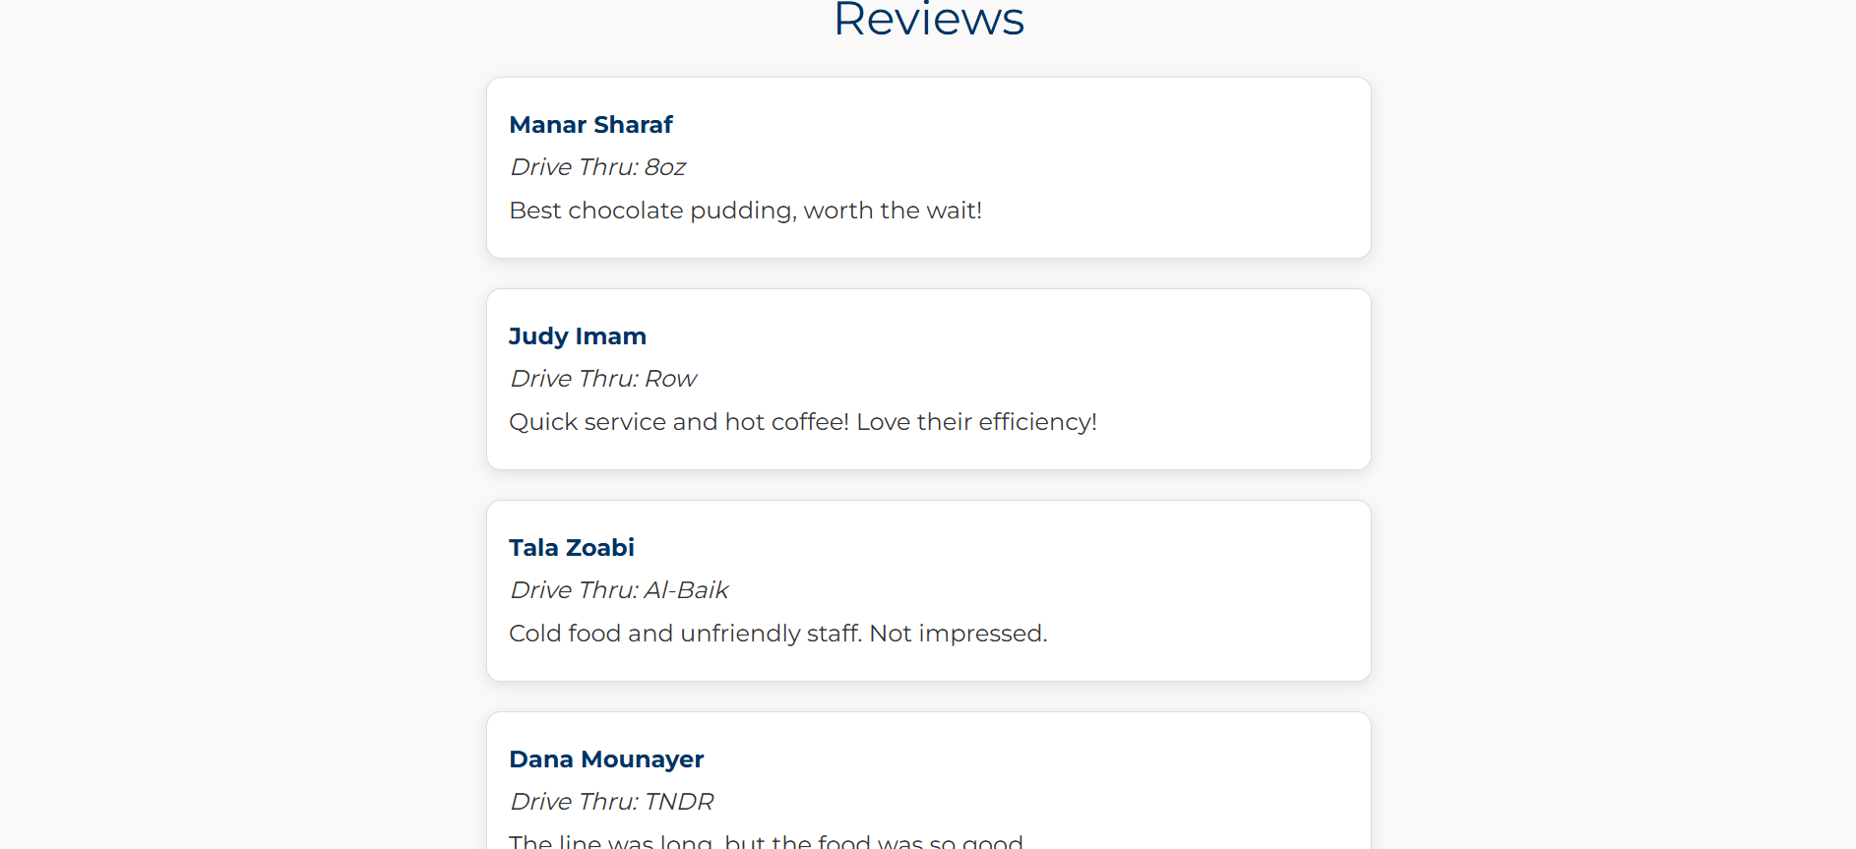
Reviews Webpage
The reviews displayed below the log in form are visible to all visitors, whether logged in or not.

Slide 12
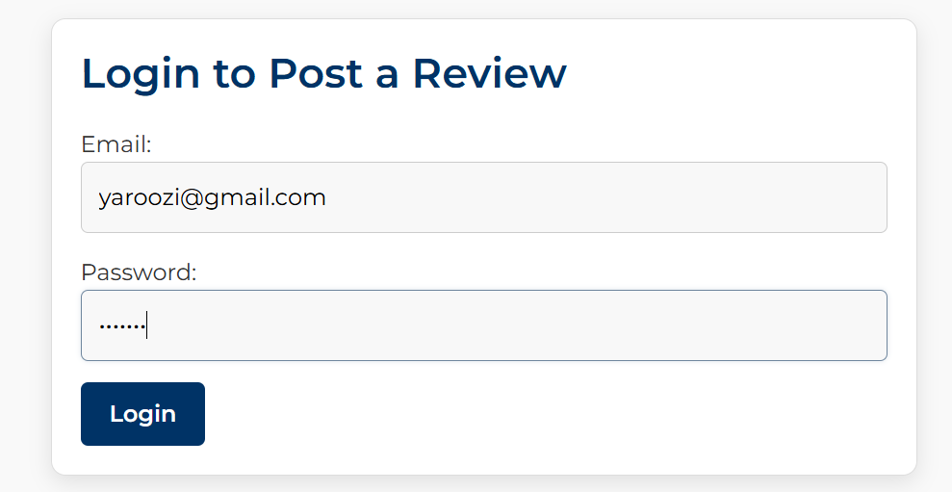
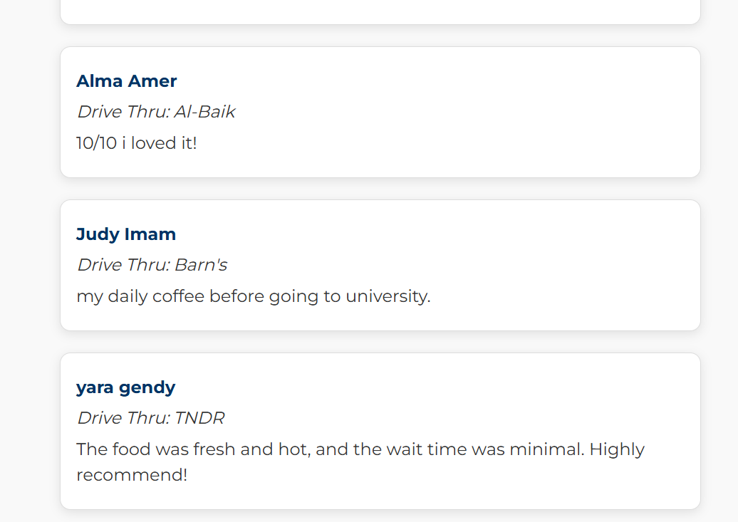
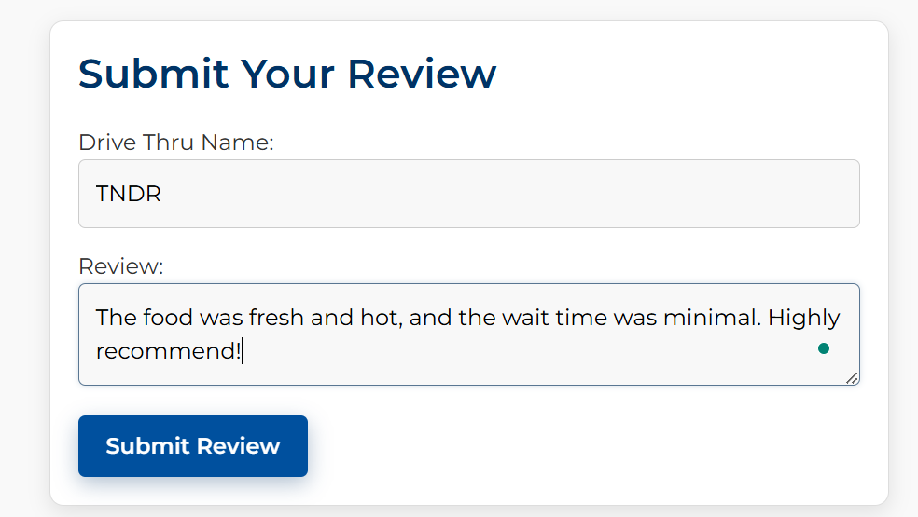

Submitting reviews form is displayed after the user logs in

Slide 13
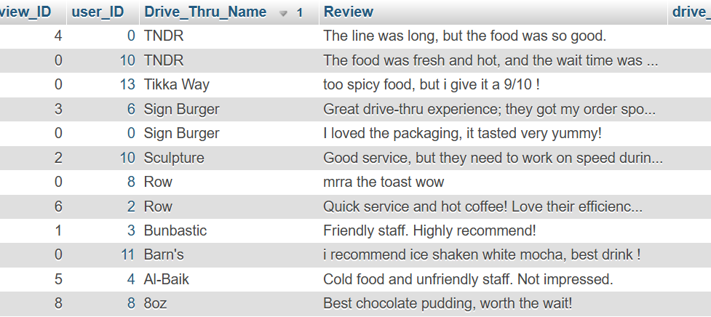
Yara’s review was added in the database in the reviews table

Slide 14
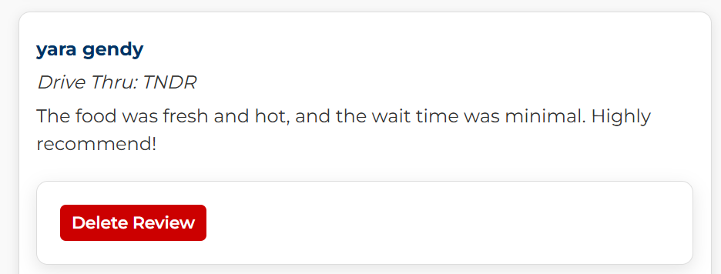
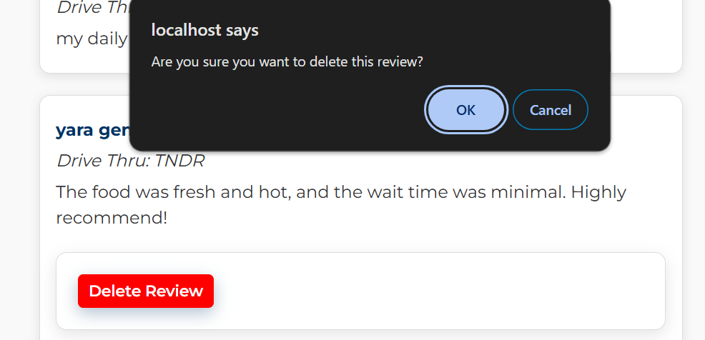
DELETING A REVIEW
We used JavaScript to prompt the user with a confirmation message when they click "Delete Review." This ensures that they are asked for confirmation before the review is permanently deleted, providing an extra layer of caution to avoid accidental deletions.

Slide 15
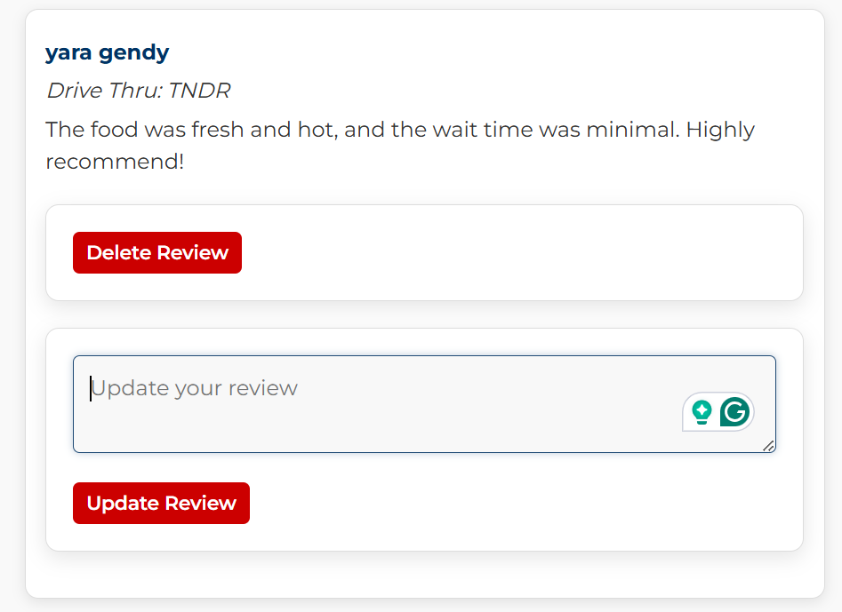
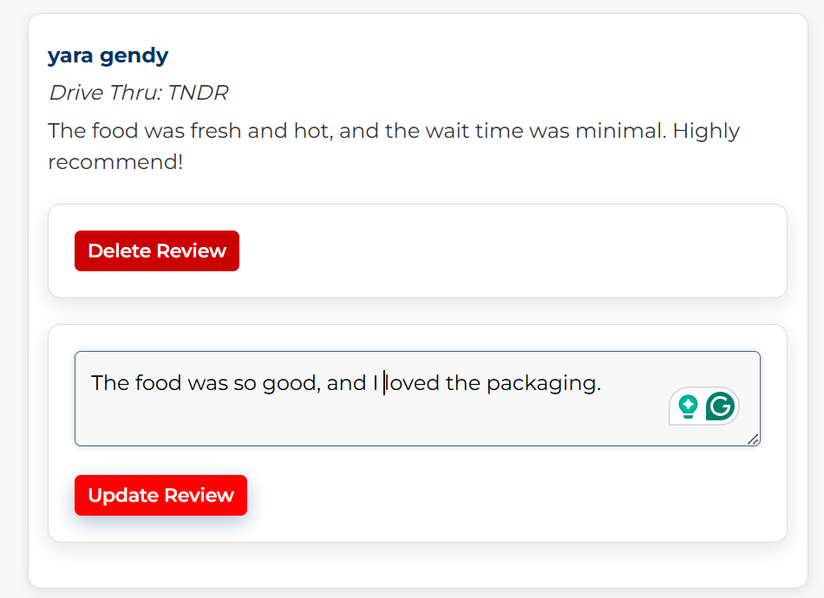
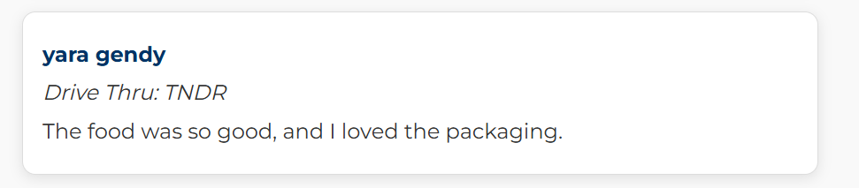
UPDATING A REVIEW

Slide 16
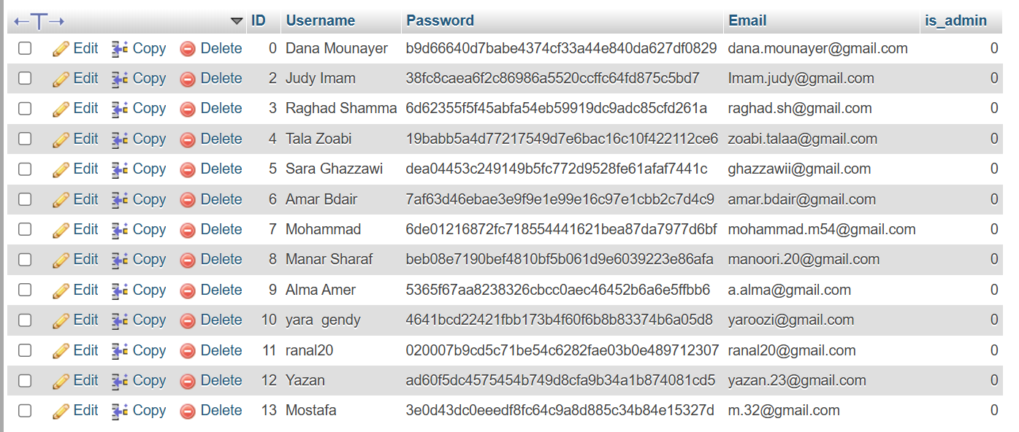
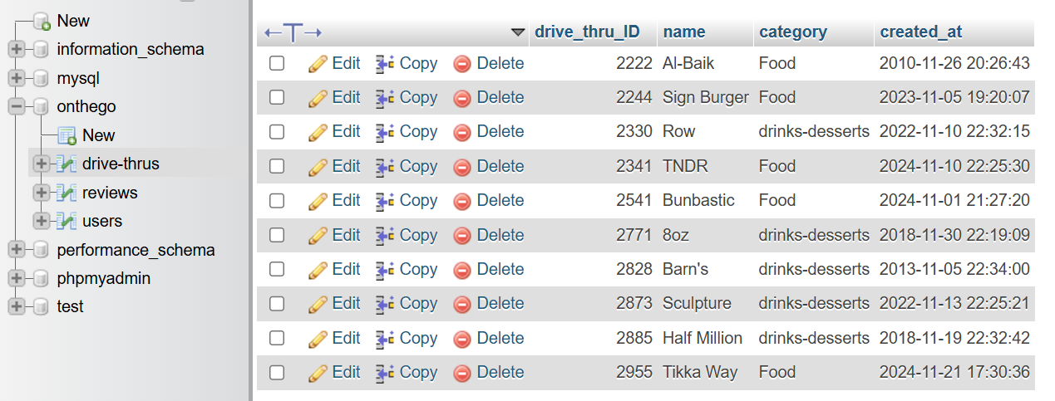
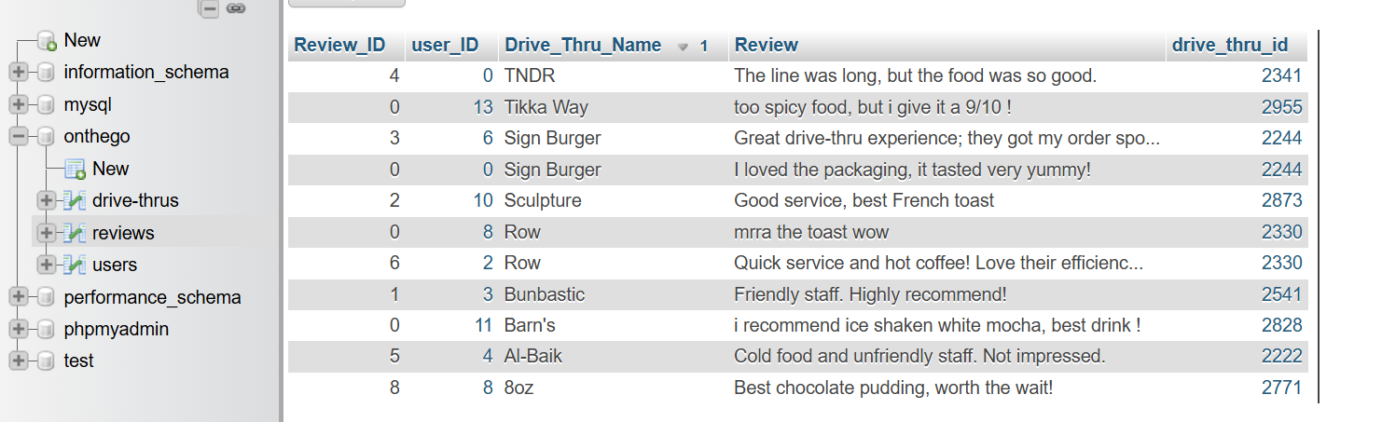
DATABASE TABLES
All passwords are securely stored as SHA1 hashes to enhance data protection and ensure the privacy of user credentials.

Slide 17
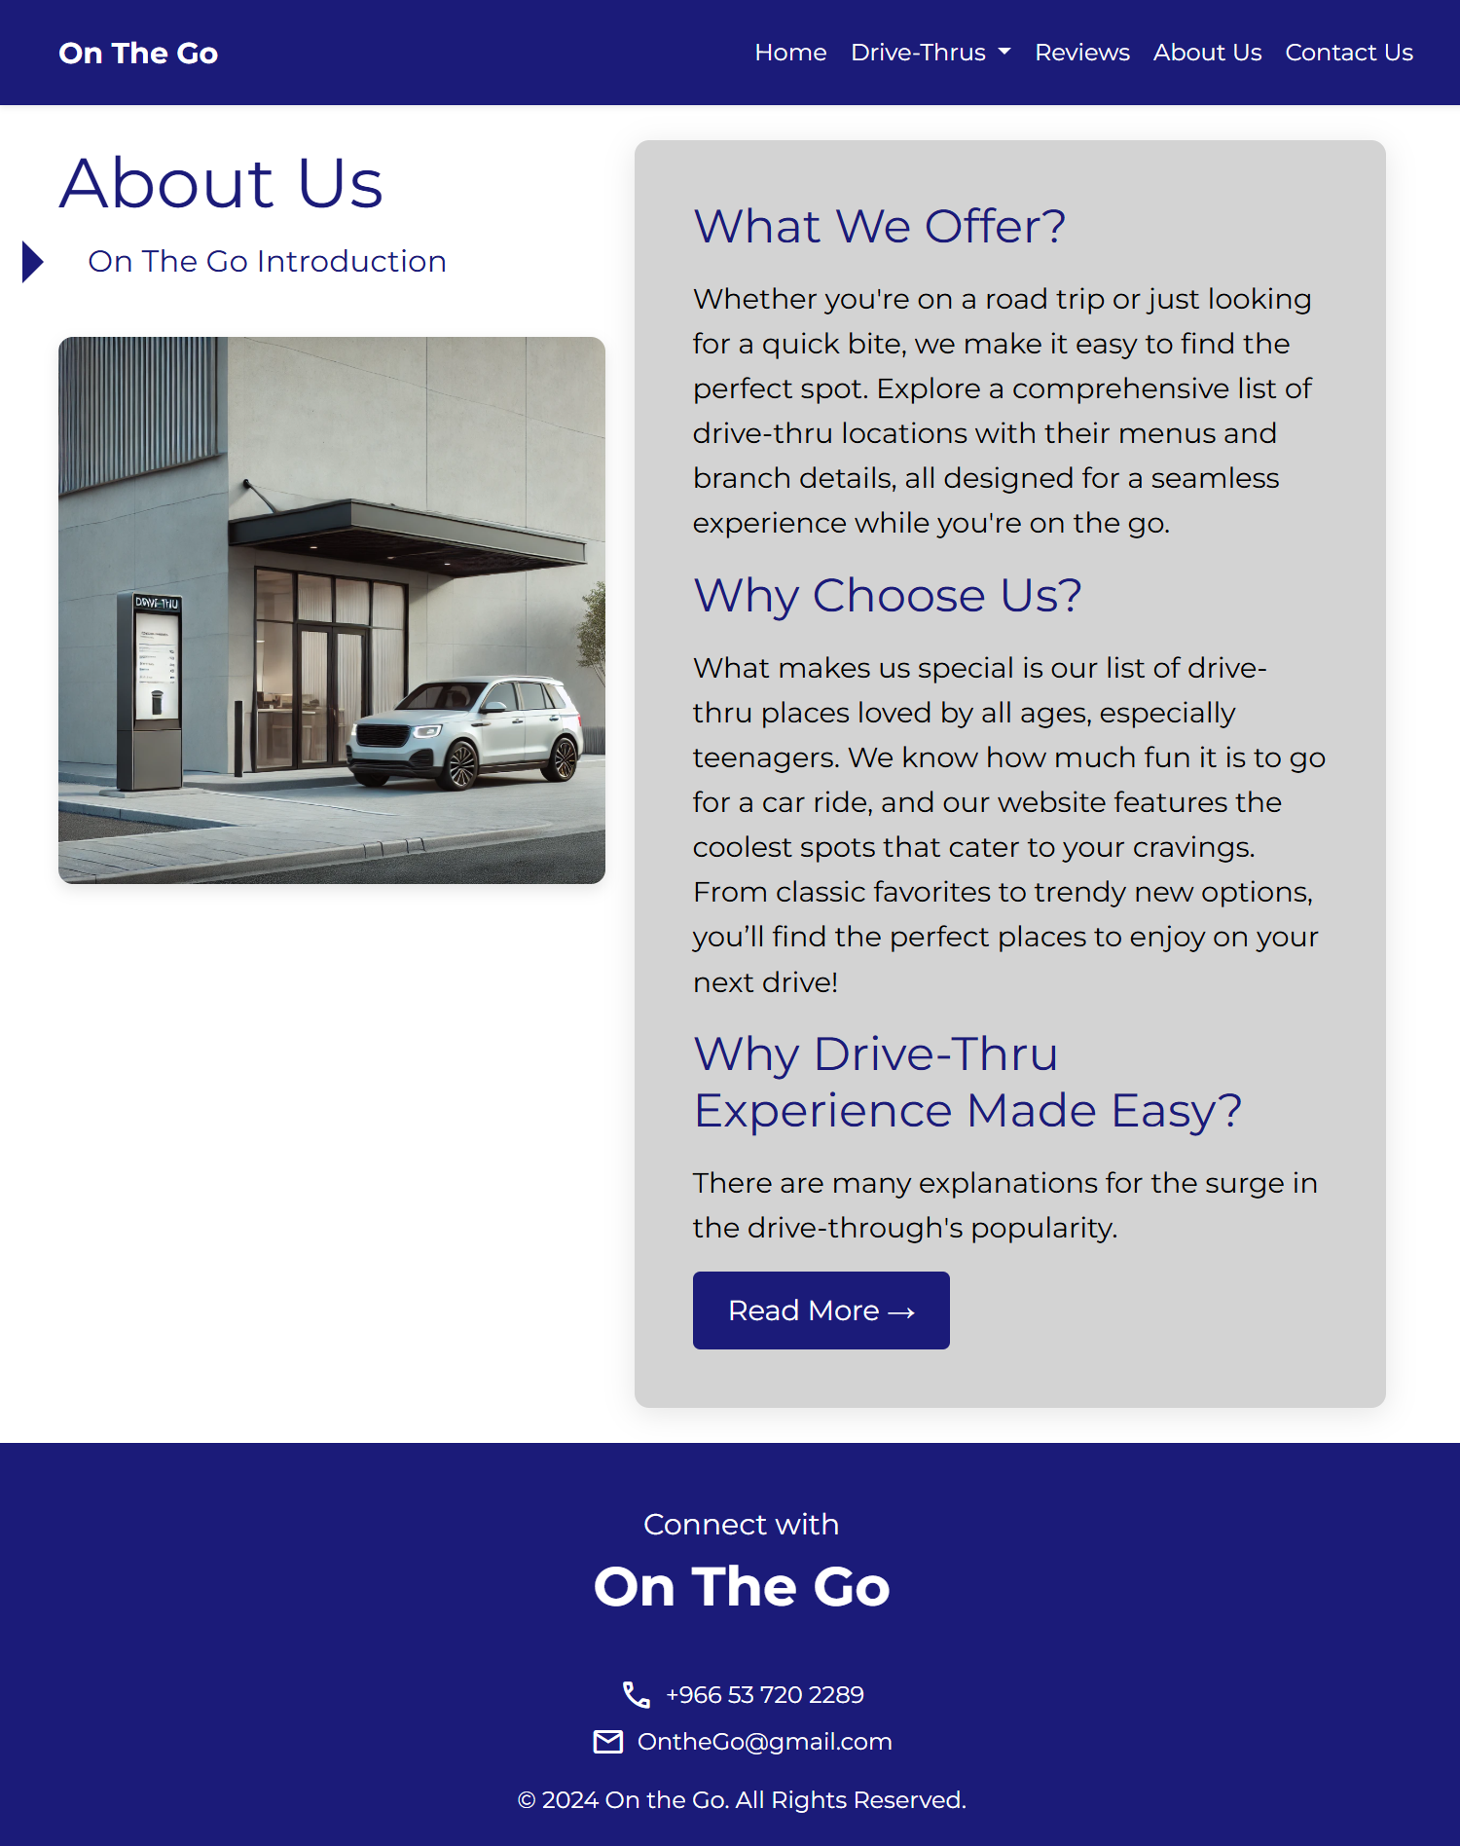
The "About Us" page introduces our website , featuring a clear layout that highlights our offerings and unique qualities. A "Read More" button, implemented using javascript, allows users to expand and read additional details seamlessly.

Slide 18
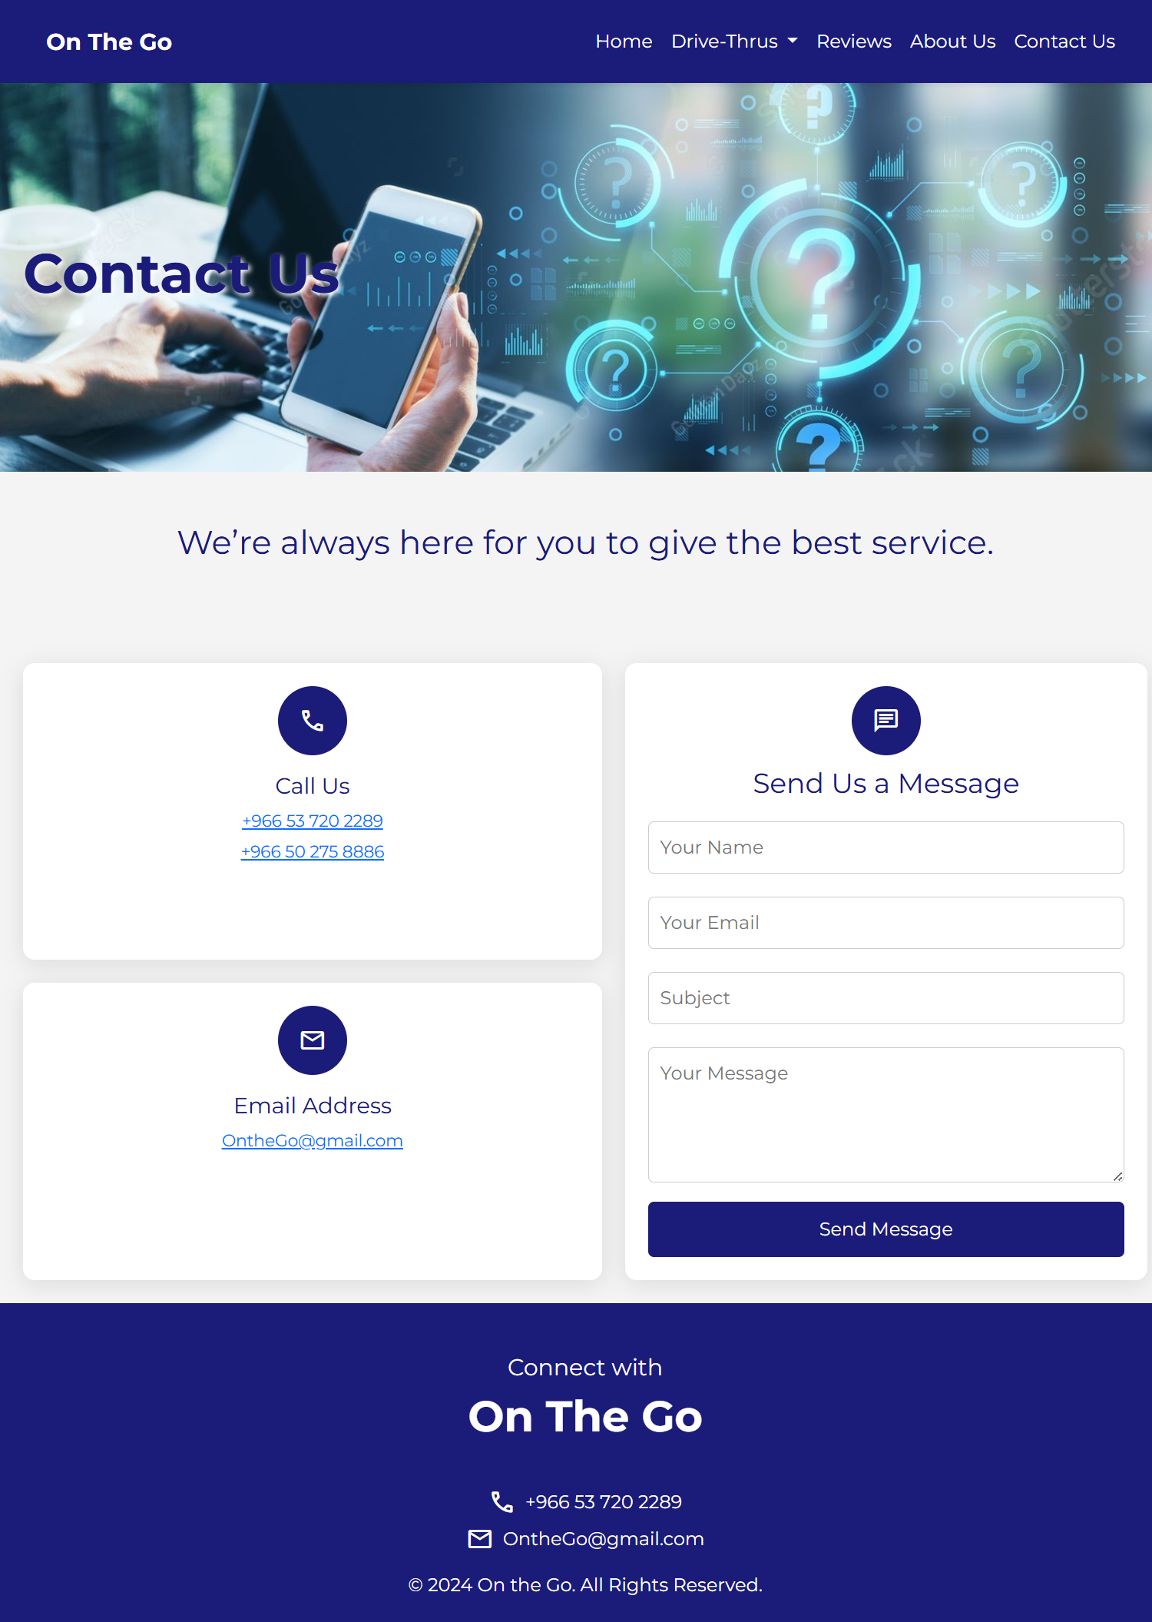
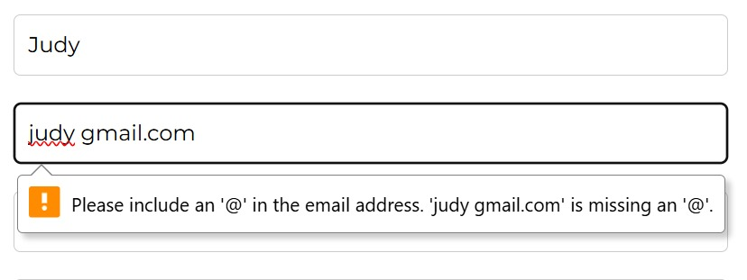
The "Contact Us" page provides users with multiple ways to reach out for assistance. It features a prominent contact section with phone numbers for direct calls and an email address for inquiries. Additionally, users can fill out a message form, which includes input validation, implemented using javascript, to ensure all required fields are completed accurately.

Slide 19
THANK YOU FOR LISTENING

